Slide 1
Basic Principles of Visualization
John F. Tripp

Slide 2
Principles of Visualization
Which of the small rectangles is lightest?

Slide 3
Principles of Visualization
Which of the small rectangles is lightest?

Slide 4
Principles of Visualization
Which of the small rectangles is lightest?

Slide 5
Principles of Visualization
#1: We do not perceive absolutes, instead we perceive relative differences.
  COMPARED TO WHAT?

Slide 6
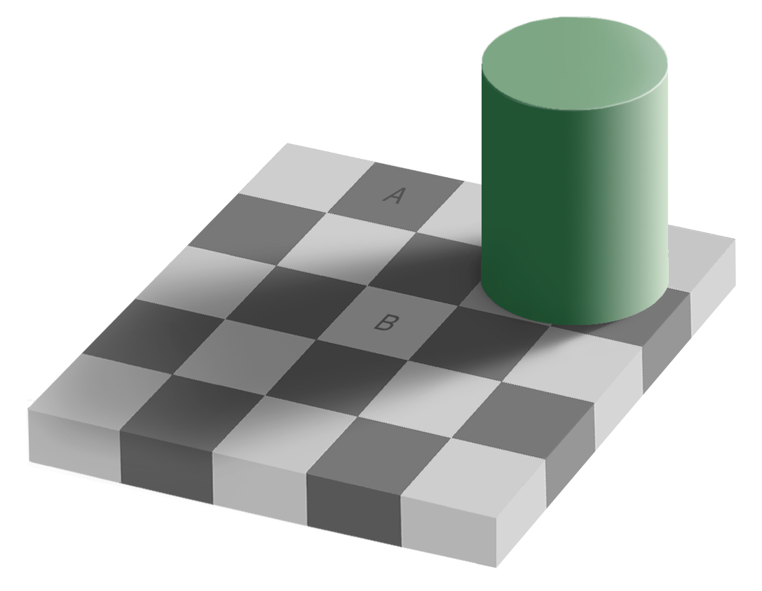
Image Source: Wikipedia

Slide 7
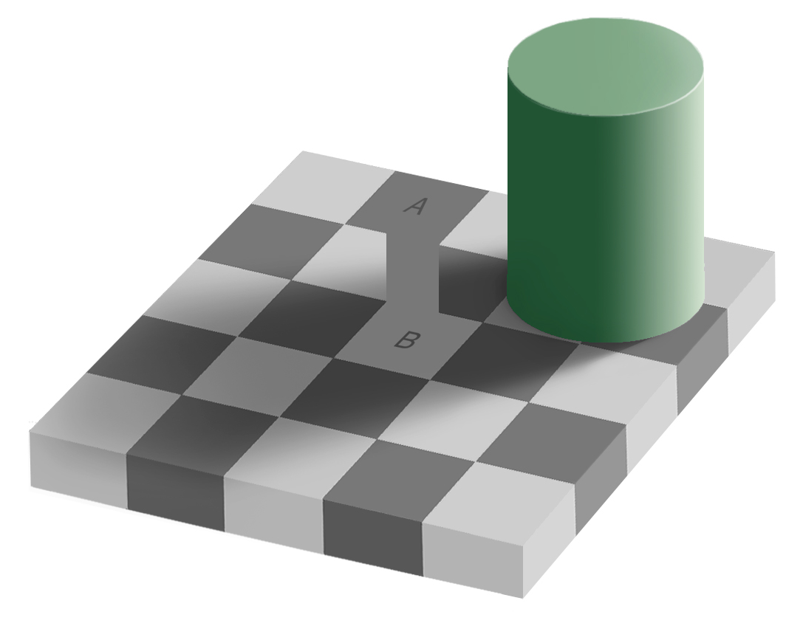
Image Source: Wikipedia

Slide 8
Principles of Visualization
We do not (and cannot) attend to everything we see.
In order to filter the huge amount of data that we receive through our eyes, the eye is drawn to the UNEXPECTED rather than consistent or expected patterns.
Differences drive attention – similarity leads a viewer to ignore things

Slide 9

Image Source: Coolbubble.com

Slide 10

Image Source: Coolbubble.com

Slide 11
Principles of Visualization
#1: We do not perceive absolutes, instead we perceive relative differences.
#2: Our brain filters out familiar patterns, and our eyes are drawn to differences

Slide 12
Principles of Visualization
Memory is extremely important in human cognition…
  Unfortunately, our memories are quite poor.

Slide 13
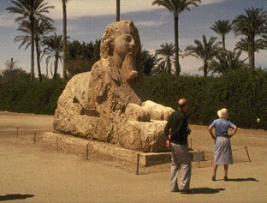
Image Source: http://www.csc.ncsu.edu/faculty/healey/HTML_papers/NPV/NPV.html

Slide 15
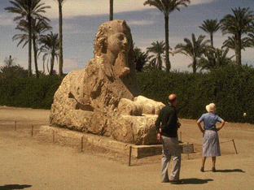
Image Source: http://www.csc.ncsu.edu/faculty/healey/HTML_papers/NPV/NPV.html

Slide 18
Principles of Visualization
#1: We do not perceive absolutes, instead we perceive differences & contrasts.
#2: Our brain ignores familiar patterns, and our eyes are drawn to differences
#3: Memory plays a role in cognition, but our working memory is very limited

Slide 19
Working Memory
Humans can “hold” between 0 and 7 “chunks” of information in working memory
  This capacity rises during maturity and falls during old age
  Typical human can hold about 4 chunks in working memory1
  Typical human can give attention to only one chunk at a time.2
¹Cowan, Nelson (1995). Attention and memory: an integrated framework. Oxford [Oxfordshire]: Oxford University Press.
²Oberauer K (May 2002). "Access to information in working memory: exploring the focus of attention". Journal of Experimental Psychology. Learning, Memory, and Cognition 28 (3): 411–21.

Slide 20

Reducing Cognitive Load
Humans have, for centuries used “artifacts” to reduce cognitive load.

Slide 21
Example: Multi-digit multiplication
paper
Mental buffer
57
X 48

Slide 22
Example: Multi-digit multiplication
paper
Mental buffer
57
X 48
[7*8 = 56]

Slide 23
Example: Multi-digit multiplication
paper
Mental buffer
5
57
X 48
[7*8 = 56]
6

Slide 24
Example: Multi-digit multiplication
paper
Mental buffer
5
57
X 48
6

Slide 25
Example: Multi-digit multiplication
paper
Mental buffer
5
57
X 48
[5*8 = 40 + 5 = 45]
456

Slide 26
Example: Multi-digit multiplication
paper
Mental buffer
5
57
X 48
456

Slide 27
Example: Multi-digit multiplication
paper
Mental buffer
5
57
X 48
[7* 4 = 28]
456
80

Slide 28
Example: Multi-digit multiplication
paper
Mental buffer
5
57
X 48
456
80

Slide 29
Example: Multi-digit multiplication
paper
Mental buffer
5
57
X 48
[5*4 = 20+2=22]
456
2280

Slide 30
Example: Multi-digit multiplication
paper
Mental buffer
5
57
X 48
456
2280

Slide 31
Example: Multi-digit multiplication
paper
Mental buffer
5
57
X 48
100
456
2280
36
[8+5 = 13]

Slide 32
Example: Multi-digit multiplication
paper
Mental buffer
5
57
X 48
100
456
2280
36

Slide 33
Example: Multi-digit multiplication
paper
Mental buffer
5
57
X 48
100
456
2280
736
[4+2=1=7]

Slide 34
Example: Multi-digit multiplication
paper
Mental buffer
5
57
X 48
00
456
2280
736

Slide 35
Example: Multi-digit multiplication
paper
Mental buffer
5
57
X 48
00
456
2280
2736

Slide 36
Excellent Graphs
Show the data – and comparisons
Illuminate the differences that make numbers interesting.
Do not require the user to “remember” or “calculate”

